Slide 1
Dog vs Cat Image Classification
Group 2
May 4, 2020

Slide 2
Outline
Background
Business Problem
Data Description
System Design
Algorithm Development
Results and Evaluation
Summary

Slide 3
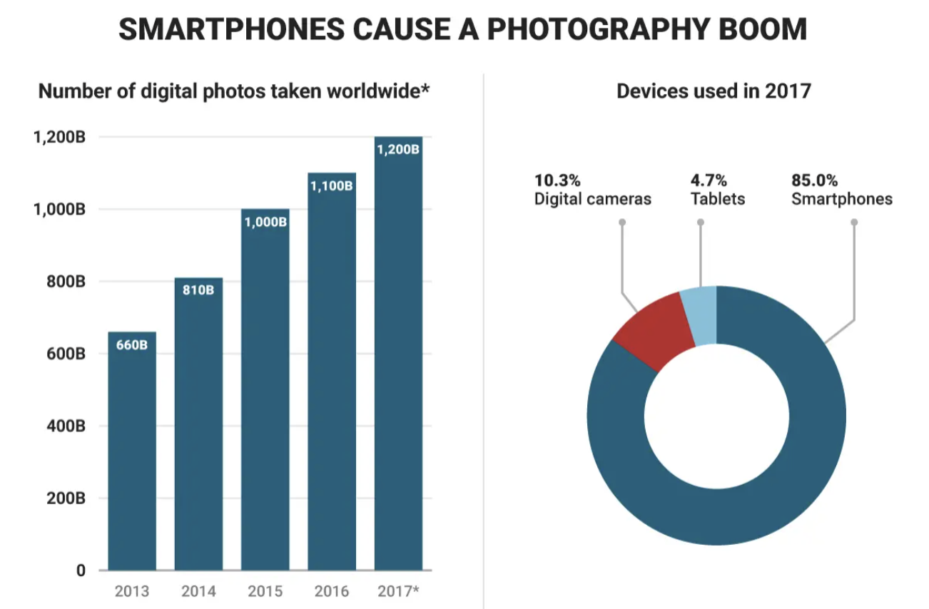
Background
Exponential growth of photographs since 2013 [1]
85% of pictures are now taken on smartphones [1]
1.2 trillion photos are predicted to be taken in 2021 [1]
Classification used to categorize and quantify characteristics of images to help understand consumer interests
[1]

Slide 4
Business Problem
How can image classification be used to categorize cats and dogs?
Object detection, face recognition, text detection, digital search, landmark detection and image composition
Used by companies such as: Shutterstock, eBay, Salesforce, Amazon, Facebook
Industries it benefits: Financial Services, Media, Automotive, Health Care, Retail
Cats vs Dogs
Can be used in marketing to classify social images as either cat vs dog and create targeted ads based on the type of pet owner
Can be used to look at pet trends for businesses to adjust certain stock or for brands to adjust pet content

Slide 5
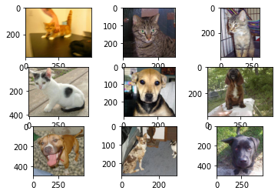
Data Description
Data: Jpeg folder of cat and dog images
Split into training set and testing set
Training set
structured data (labeled)
25,001 images
Testing set
unstructured data (not labeled)
12,500 images
Data source: Kaggle Platform
Data format: Jpeg
Data size: .9344 GB

Slide 6
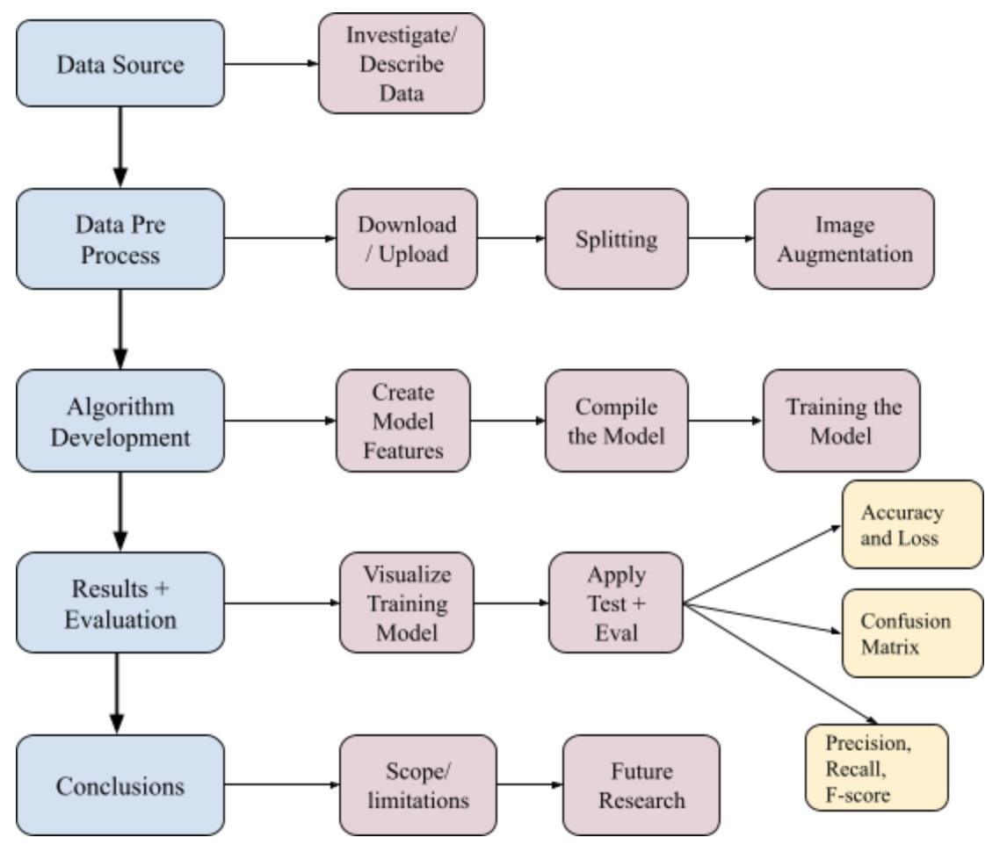
System Design

Slide 7
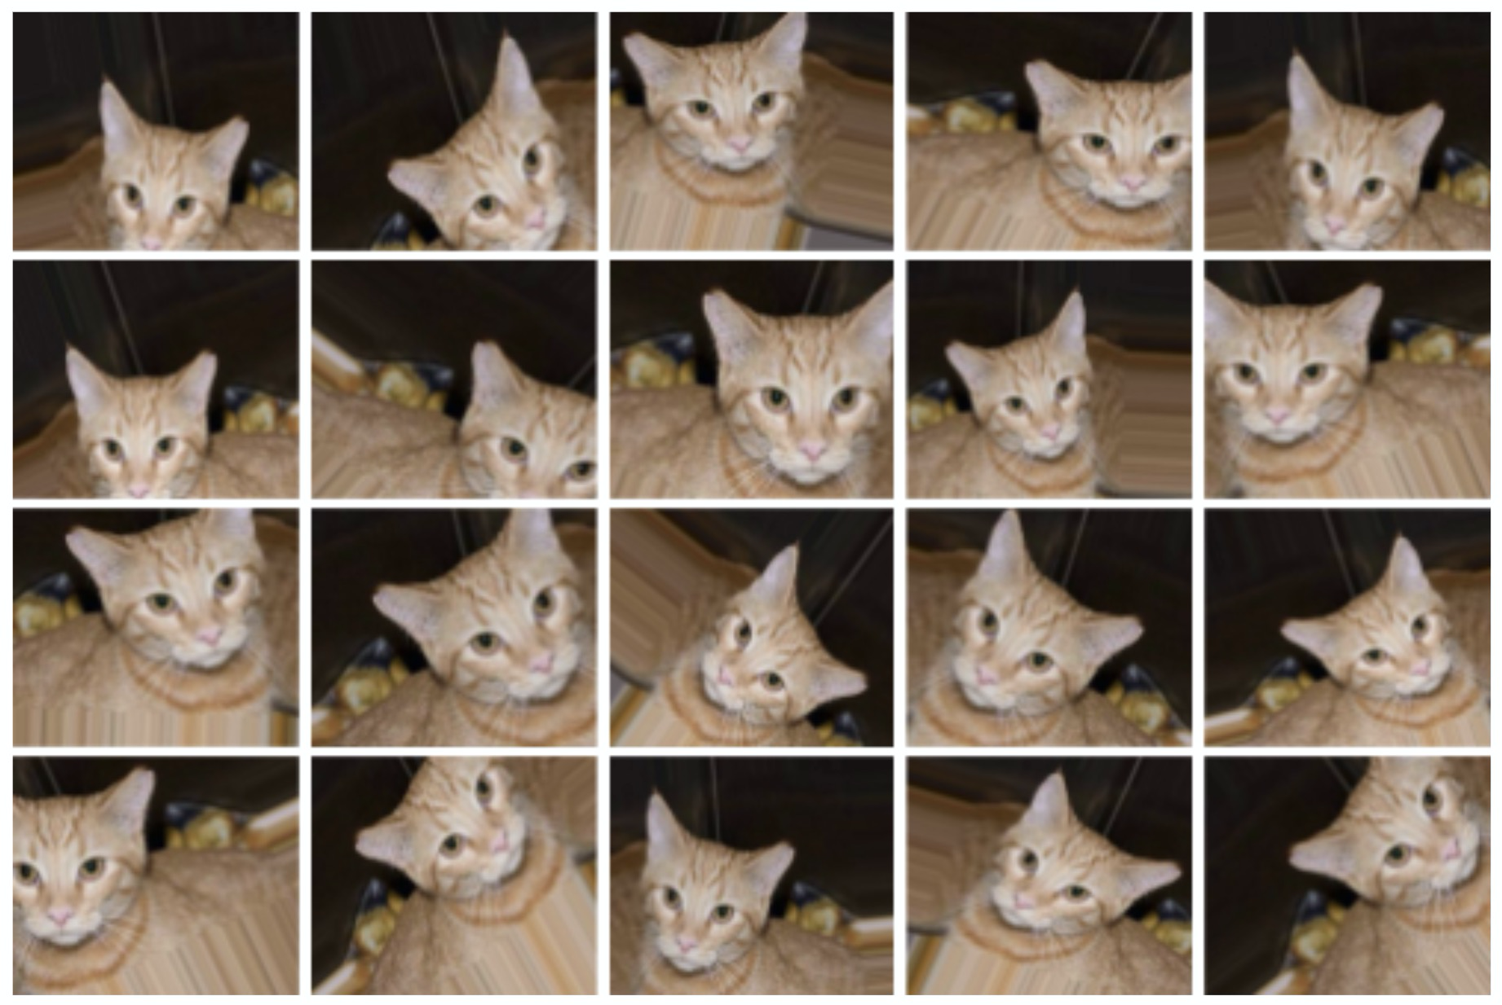
Data Preprocessing
Downloading/Uploading
Splitting into Training and Validation, Cat vs Dog
25% of the training data was taken and put into the validation set
Using ImageDataGenerator for Image Augmentation
Rescales and augments data with a random number of transformations to improve the amount of data available
Example of Image Augmentation for a Single Photo

Slide 8
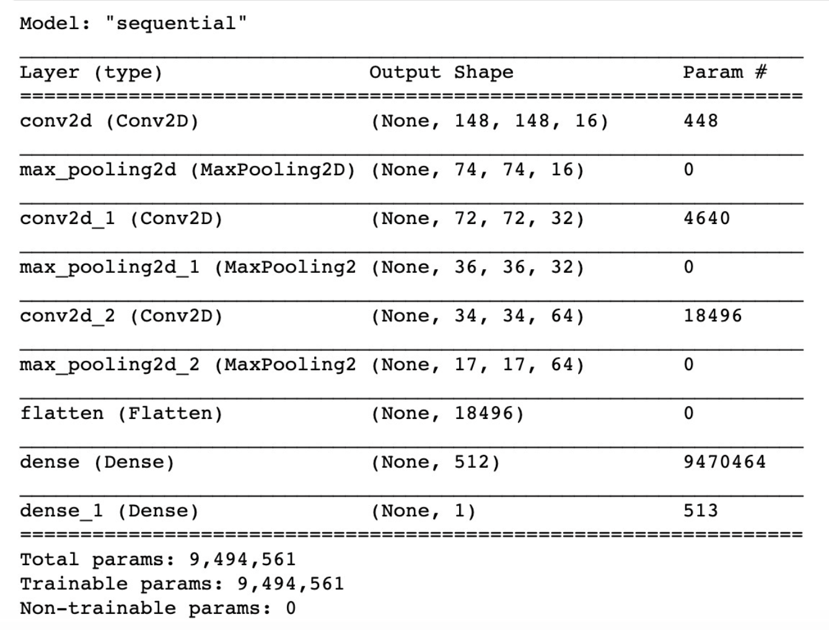
Algorithm Development
Creating Model Parameters/Features
Sequential from keras.model creates model parameters, grouping a linear stack of layers into a comprehensive model.
These layers, from keras.layers, include Dense, Conv2D, MaxPool2D, and Flatten.
Cov2D: apply filter to original image to exaggerate certain features
MaxPool2D: Reduces size of image and parameters, therefore reducing training time
Flatten: convert our 3D feature maps to 1D feature vectors
Dense: calls the dimensionality of the output space, including implementing the activation function (used both ‘relu’ and ‘sigmoid’)
Summary of the Model and Layers

Slide 9
Algorithm Development
Compile Model
Defines the loss function, the optimizer, and the metrics
Loss function: Binary Cross Entropy
Optimizer: Adam
Metrics: Accuracy
Training the model
Neural network model
Steps per epoch = 93
processes 93 batches per epoch
Number of Epochs = 50
one epoch is one time the data has passed through the model, or one learning cycle
Output is accuracy and loss for training set and validation set for each epoch

Slide 10
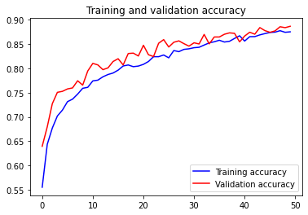
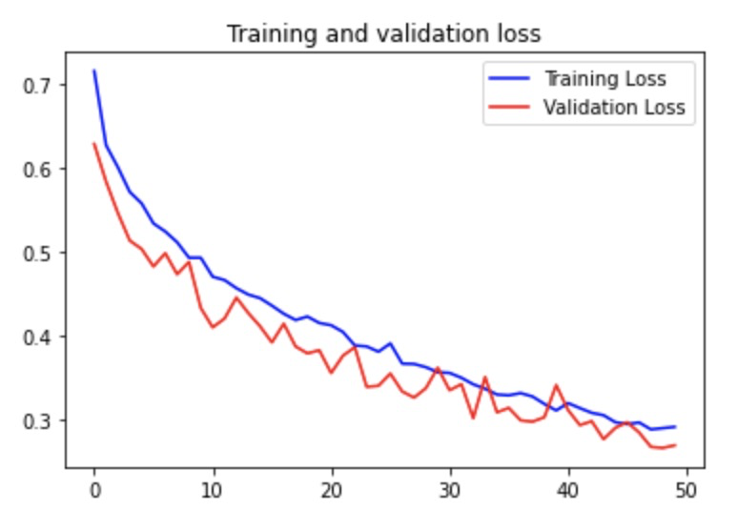
Result and Evaluation
Visualizing the training data
In the plots here is a learning curve for both validation and training loss and accuracy over the time of the 50 epochs
Training and validation for accuracy climbs slowly to just below .9 or 90%.
The last epoch reaches the highest accuracy of training accuracy of 0.87 and validation accuracy of 0.8867.
Training and validation loss decreases slowly to just below .3.
The loss for the last epoch is 0.2811 for training and 0.2689 for validation.
Training and Validation Accuracy and Loss Plots

Slide 11
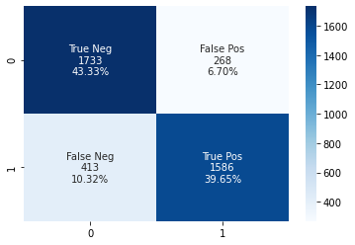
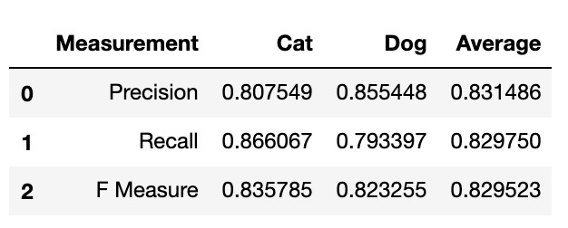
Result and Evaluation
1 = Dog, 0 = Cat
Applying Model to Test Data and Evaluating
Used 4000 manually labeled test images
Model. Evaluate
Applied the training model above to the images and got an accuracy of .895 and a loss of .26.
Confusion Matrix
86% of all dog predictions were right and 15 % of all dog predictions were wrong and 81% of all cat predictions were right and 19% of all cat predictions were wrong.
Precision, Recall and F Measure
Dog has better precision, Cat has a better recall - but cat has a better F measure
Model is better at predicting cat
Confusion Matrix and Precision, Recall, and F score Table

Slide 12
Conclusion, Limitations, & Future Steps
Conclusions
With a high accuracy and a low loss, the model can be used on images to classify in order to be used in real world business problems such as discovering trends related to stock and content creation.
Model can be optimized when wanting to classify cat images to look at cat specific trends (since cat classifications were better)
Limitations
Companies try to implement image processing algorithms and creating the algorithm and running the models end up being expensive (if you do not run enough epochs) and time consuming(if you have to run a lot of models with alot of epochs/steps per epoch).
Not being able to tweak with model layers and different optimizers since the run times are long
Future research
Investigating false negatives and false positives (a.k.a misclassifications)
What about the pictures wrongly identified the class
Classifying beyond binary classification.
Classifying by breed or classifying with more animals

Slide 13
References
https://www.businessinsider.com/12-trillion-photos-to-be-taken-in-2017-thanks-to-smartphones-chart-2017-8
https://www.newgenapps.com/blog/how-image-recognition-will-transform-businesses/
Data: https://www.kaggle.com/tongpython/cat-and-dog

